Slide 1

Predictive Regression Using feature selection
By: Joe Cornelius & John DiTaranto

Slide 2
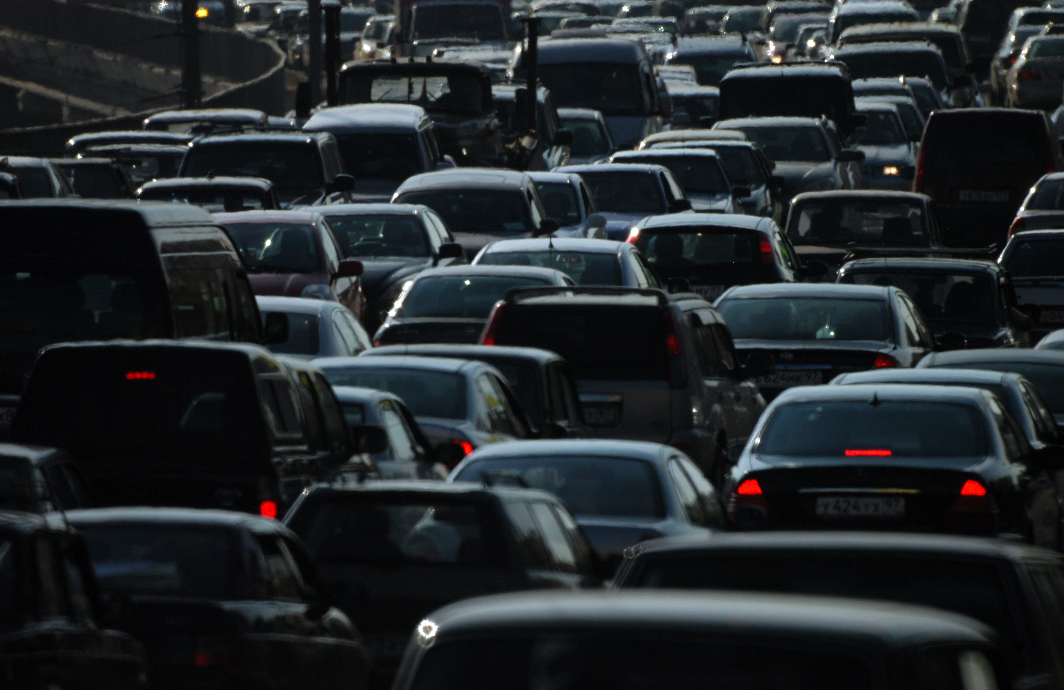
Dataset
For this project, we chose the Automobile dataset
Different from the Auto MPG dataset
Additional 17 variables
Allowed for additional techniques to be explored
https://archive.ics.uci.edu/ml/datasets/Automobile

Slide 3
Our Objectives
Goal: See if feature selection helps increase the accuracy of the MPG predictions
Regression
City & Highway
To test this regression problem, we will be exploring:
Nearest Neighbor
Feature Selection
Goal: Find the most important variables and test versus the entire set.
Cross-Validation

Slide 4
Pre-Processing
Cleaning the dataset
Remove columns/rows with blanks
Found several unrealistic values
Clean up and or remove
Focus on optimizing the algorithm – emphasis on training
Supervised Learning
Train: 75%
Test: 25%

Slide 5
Results
Nearest Neighbor
Tested with different numbers of neighbors, valued 3-10
No one value was collectively better
Each section worked optimally when using a different number of neighbors
Cross Validation
Grid Search
Found the hyperparameters that yielded the optimal score(s)
For each segment, the testing set yielded a higher R² value
This proves that the machine improved itself

Slide 6
Results
Feature Selection
Decided ahead of time on what we felt were most intuitively helpful
Horsepower
Number of Cylinders
Curb-Weight
R² value when given the entire dataset:
City: 0.8761
Highway: 0.8137
R² value when given the feature selected dataset:
City: 0.8579
Highway: 0.8380

Slide 7
Results
From the aforementioned values, we see a few things:
With or without feature selection, the machine is extremely accurate
Feature selection improvements?
Improved Highway
Actually, worsened for city
Why?
More variables when driving in a city, coincides with gas milage variability
Did not try many combinations of features

Slide 8



What’s Ahead?
Conclusion
Both nearest neighbor and feature selection were successful
With more time and iterations, significant improvements expected
Limitations
Variables
Extreme Differences in cars
Electric Cars were not considered
Future Work
The focus of AI in the field of automobiles is not in fuel efficiency
Instead, most work is going towards self-driving cars
Fully autonomous is not here yet, but soon

